Slide 1
CENG 3430 Course Project
Mo Yu Hin (1155116319)

Slide 2
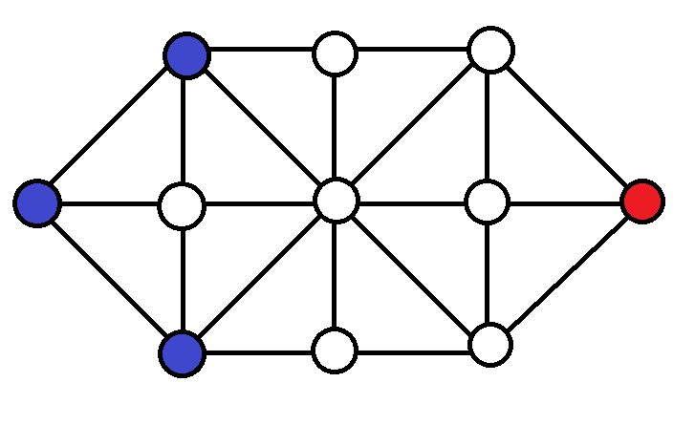
Project Design
one Player becomes the cops, which is the Blue side
another player will become the thief, which is the red side.

Slide 3
Rules of the Games:
Blue always goes first
Nodes can move to the nodes next to it only
Blue nodes can only move forward
If Red node can’t move, Blue Win
If Red node cross the encircle of the Blues team, Red Wins
If Turns > 30, Red Wins

Slide 4
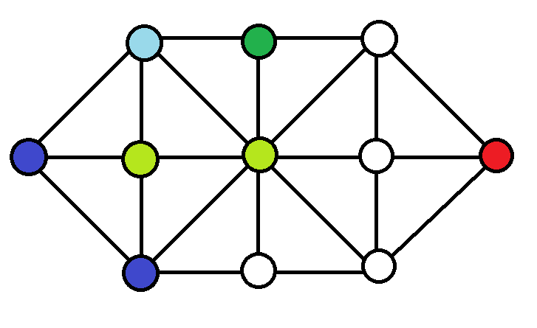
Movement(1)

Slide 5
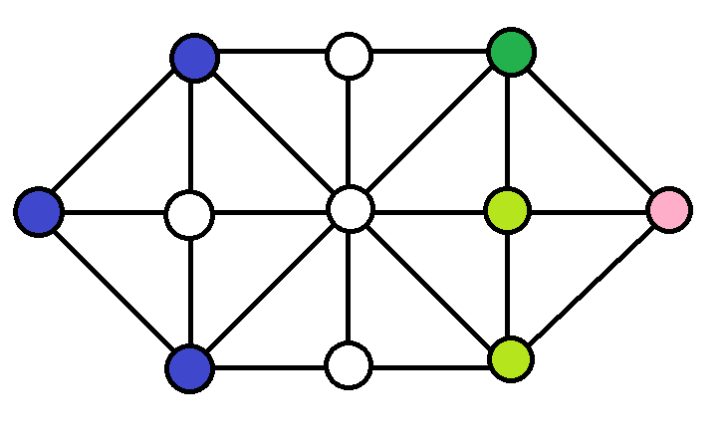
Movement(2)

Slide 6
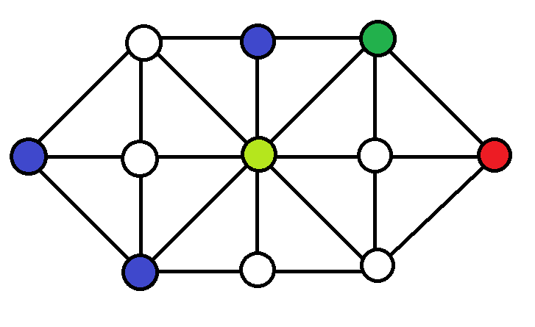
Movement(3)

Slide 7
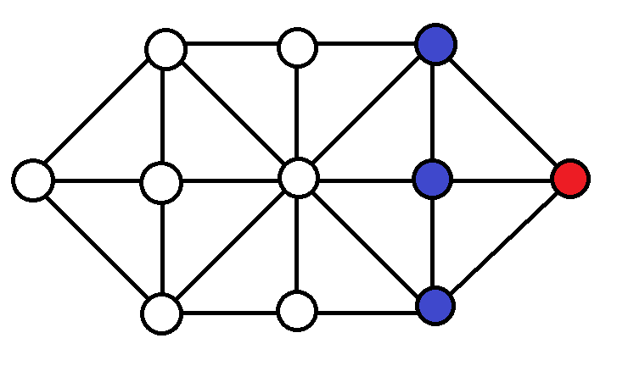
Win Case → Blue: Red can’t move

Slide 8
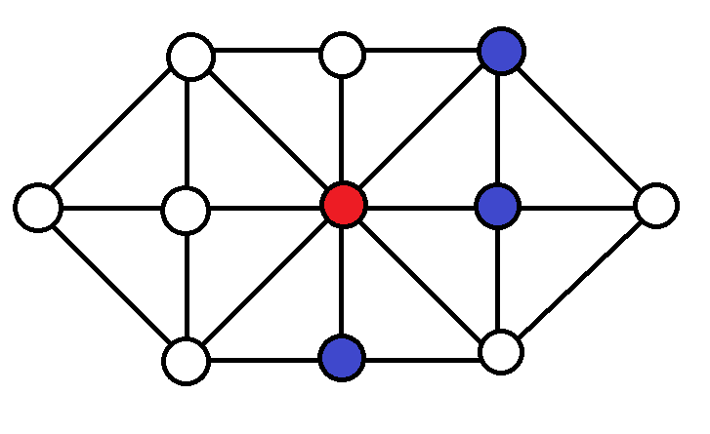
Win Case → Red: Cross the Encircle

Slide 9
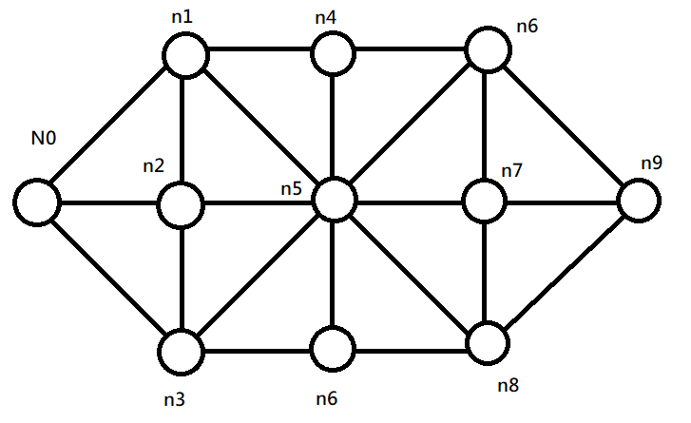
Nodes Design

Slide 10
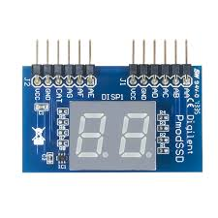
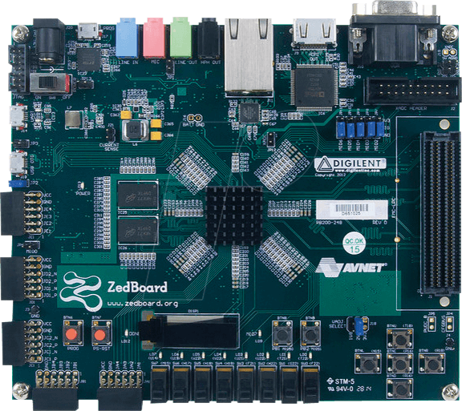
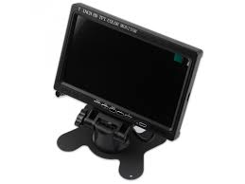
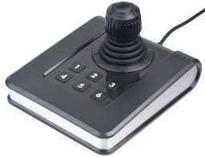
Hardware Required:

Slide 11
~END~

